Slide 1
Advanced Programming Lab
1
Starting Out with C++
-Prastab Dhakal

Slide 2
History of C and C++
History of C
  Evolved from two other programming languages
    BCPL and B
  Dennis Ritchie (Bell Laboratories)
    Added data typing, other features
  Development language of UNIX
  Hardware independent
    Portable programs
  1989: ANSI standard
  1990: ANSI and ISO standard published
    ANSI/ISO 9899: 1990

Slide 3
History of C and C++
History of C++
  Extension of C
  Early 1980s: Bjarne Stroustrup (Bell Laboratories)
  Provides capabilities for object-oriented programming
    Objects: reusable software components
      Model items in real world
    Object-oriented programs
      Easy to understand, correct and modify
  Hybrid language
    C-like style
    Object-oriented style
    Both

Slide 4
C++ Standard Library
C++ programs
  Built from pieces called classes and functions
C++ standard library
  Rich collections of existing classes and functions
“Building block approach” to creating programs
  “Software reuse”

Slide 5
The Key Software Trend: Object Technology
Objects
  Reusable software components that model real world items
  Meaningful software units
    Date objects, time objects, paycheck objects, invoice objects, audio objects, video objects, file objects, record objects, etc.
    Any noun can be represented as an object
  More understandable, better organized and easier to maintain than procedural programming
  Favor modularity
    Software reuse

Slide 6
Program to Display Hello world in C
#include <stdio.h>
int main(){
printf(“Hello world”);
return 0;
}

Slide 7
Basics of a Typical C++ Environment
C++ systems
  Program-development environment
  Language
  C++ Standard Library
C++ program names extensions
  .cpp
  .cxx
  .cc
  .C

Slide 8
Basics of a Typical C++ Environment
Phases of C++ Programs:
  Edit
  Preprocess
  Compile
  Link
  Load
  Execute
Program is created in
the editor and stored
on disk.
Editor
Disk
Preprocessor
Disk
Preprocessor program
processes the code.
Compiler creates
object code and stores
it on disk.
Compiler
Disk
Linker links the object
code with the libraries,
creates an executable file and stores it on disk
Linker
Disk
Primary
Memory
Loader
Loader puts program
in memory.
Disk
.
.
.
.
.
.
Primary
Memory
CPU
CPU takes each
instruction and
executes it, possibly
storing new data
values as the program
executes.
.
.
.
.
.
.

Slide 9
Basics of a Typical C++ Environment
Common Input/output functions
  cin
    Standard input stream
    Normally keyboard
  cout
    Standard output stream
    Normally computer screen
  cerr
    Standard error stream
    Display error messages

Slide 10
A Simple Program: Printing a Line of Text
Before writing the programs
  Comments
    Document programs
    Improve program readability
    Ignored by compiler
    Single-line comment
      Use C’s comment /* .. */ OR Begin with // or
  Preprocessor directives
    Processed by preprocessor before compiling
    Begin with #

Slide 11
fig01_02.cpp
(1 of 1) fig01_02.cpp output (1 of 1)
1 // Fig. 1.2: fig01_02.cpp
2 // A first program in C++.
3 #include <iostream>
4
5 // function main begins program execution
6 int main()
7 {
8 std::cout << "Welcome to C++!\n";
9
10 return 0; // indicate that program ended successfully
11
12 } // end function main
Single-line comments.
Function main returns an integer value.
Left brace { begins function body.
Preprocessor directive to include input/output stream header file <iostream>.
Function main appears exactly once in every C++ program..
Statements end with a semicolon ;.
Corresponding right brace } ends function body.
Stream insertion operator.
Name cout belongs to namespace std.
Keyword return is one of several means to exit function; value 0 indicates program terminated successfully.
Welcome to C++!

Slide 12
A Simple Program: Printing a Line of Text
Standard output stream object
  std::cout
  “Connected” to screen
  <<
    Stream insertion operator
    Value to right (right operand) inserted into output stream
Namespace
  std:: specifies using name that belongs to “namespace” std
  std:: removed through use of using statements
Escape characters
  \
  Indicates “special” character output

Slide 13
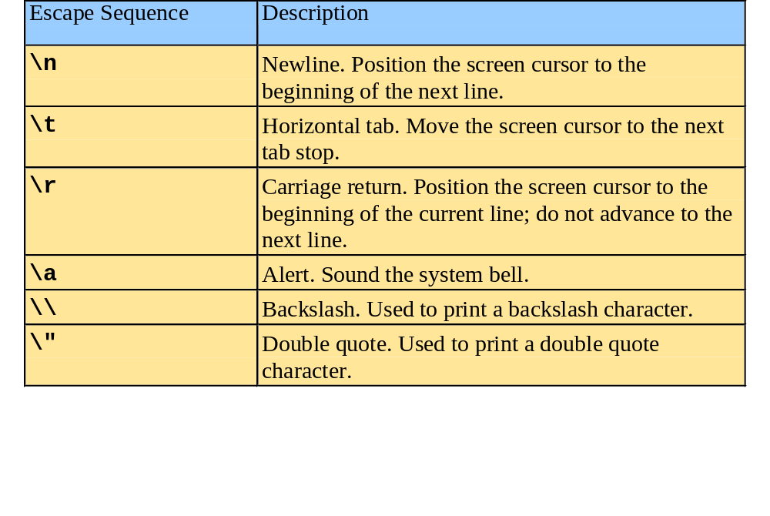
A Simple Program: Printing a Line of Text

Slide 14
Another Simple Program: Adding Two Integers
Variables
  Location in memory where value can be stored
  Common data types
    int - integer numbers
    char - characters
    double - floating point numbers
  Declare variables with name and data type before use
    int integer1;
    int integer2;
    int sum;
  Can declare several variables of same type in one declaration
    Comma-separated list
    int integer1, integer2, sum;

Slide 15
Primitive Built-in Data Types
Data Type | Keyword | Size | Range
Boolean | bool | 1 Byte | True Or False
Character | char | 1 Byte | -127 to 127 or 0 to 255
Integer | int | 4 Bytes | -2147483648 to 2147483647
Float | float | 4 Bytes | +/- 3.4e +/- 38 (~7 digits)
Double | double | 8 Bytes | +/- 1.7e +/- 308 (~15 digits)

Slide 16
DATA TYPE | SIZE (IN BYTES) | RANGE
short int | 2 | -32,768 to 32,767
unsigned short int | 2 | 0 to 65,535
unsigned int | 4 | 0 to 4,294,967,295
int | 4 | -2,147,483,648 to 2,147,483,647
long int | 4 | -2,147,483,648 to 2,147,483,647
unsigned long int | 4 | 0 to 4,294,967,295
long long int | 8 | -(2^63) to (2^63)-1
unsigned long long int | 8 | 0 to 18,446,744,073,709,551,615
signed char | 1 | -128 to 127
unsigned char | 1 | 0 to 255
float | 4 | +/-3.4e +/-38(~7 digits)
double | 8 | +/-1.7e +/-308(~15digits)
long double | 12
wchar_t | 2 or 4 | 1 wide character

Slide 17
WAP to produce correct size of various data types on your computer
#include <iostream>
using namespace std;
int main() {
cout << "Size of char : " << sizeof(char) << endl;
cout << "Size of int : " << sizeof(int) << endl;
cout << "Size of short int : " << sizeof(short int) << endl;
cout << "Size of long int : " << sizeof(long int) << endl;
cout << "Size of float : " << sizeof(float) << endl;
cout << "Size of double : " << sizeof(double) << endl;
cout << "Size of wchar_t : " << sizeof(wchar_t) << endl;
return 0;
}

Slide 18
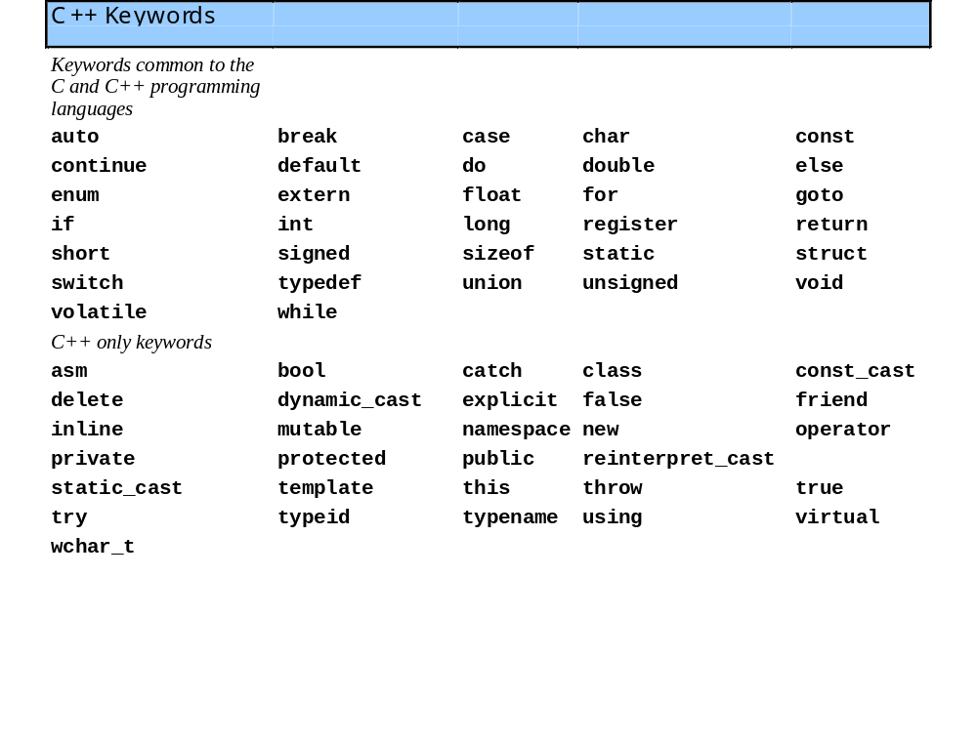
Keywords
C++ keywords
  Cannot be used as identifiers or variable names

Slide 19
Another Simple Program: Adding Two Integers
Input stream object
  >> (stream extraction operator)
    Used with std::cin
    Waits for user to input value, then press Enter (Return) key
    Stores value in variable to right of operator
      Converts value to variable data type
= (assignment operator)
  Assigns value to variable
  Binary operator (two operands)
  Example:
      sum = variable1 + variable2;

Slide 20
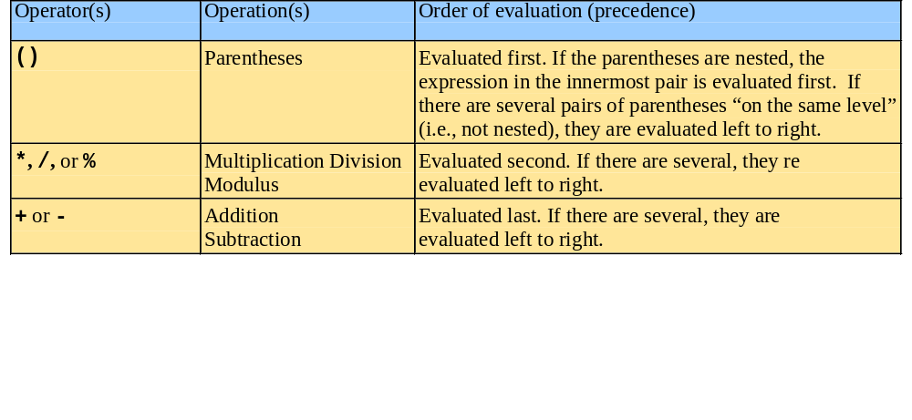
Arithmetic
Arithmetic calculations
  * : Multiplication
  / : Division
    Integer division truncates remainder
      7 / 5 evaluates to 1
  % : Modulus operator returns remainder
      7 % 5 evaluates to 2

Slide 21
fig01_06.cpp
(1 of 1)
1 // Fig. 1.6: fig01_06.cpp
2 // Addition program.
3 #include <iostream>
4
5 // function main begins program execution
6 int main()
7 {
8 int integer1; // first number to be input by user
9 int integer2; // second number to be input by user
10 int sum; // variable in which sum will be stored
11
12 std::cout << "Enter first integer\n"; // prompt
13 std::cin >> integer1; // read an integer
14
15 std::cout << "Enter second integer\n"; // prompt
16 std::cin >> integer2; // read an integer
17
18 sum = integer1 + integer2; // assign result to sum
19
20 std::cout << "Sum is " << sum << std::endl; // print sum
21
22 return 0; // indicate that program ended successfully
23
24 } // end function main
Declare integer variables.
Use stream extraction operator with standard input stream to obtain user input.
Calculations can be performed in output statements: alternative for lines 18 and 20:
std::cout << "Sum is " << integer1 + integer2 << std::endl;
Stream manipulator std::endl outputs a newline, then “flushes output buffer.”
Concatenating, chaining or cascading stream insertion operations.

Slide 22
fig01_06.cpp
(1 of 1)
1 // Fig. 1.6: fig01_06.cpp
2 // Addition program.
3 #include <iostream>
4 using namespace std;
5 // function main begins program execution
6 int main()
7 {
8 int integer1; // first number to be input by user
9 int integer2; // second number to be input by user
10 int sum; // variable in which sum will be stored
11
12 cout << "Enter first integer\n"; // prompt
13 cin >> integer1; // read an integer
14
15 cout << "Enter second integer\n"; // prompt
16 cin >> integer2; // read an integer
17
18 sum = integer1 + integer2; // assign result to sum
19
20 cout << "Sum of " << integer1 << “and” << integer2 << “is”
21 cout << sum << std::endl; // print sum
22
23 return 0; // indicate that program ended successfully
24 } // end function main

Slide 23
Memory Concepts
Variable names
  Correspond to actual locations in computer's memory
  Every variable has name, type, size and value
  When new value placed into variable, overwrites previous value
  std::cin >> integer1;
  Assume user entered 45
  std::cin >> integer2;
  Assume user entered 72
  sum = integer1 + integer2;
integer1
45
integer1
45
integer2
72
integer1
45
integer2
72
sum
117

Slide 24
WAP to demonstrate usage of string header
#include <iostream>
#include <string>
using namespace std;
int main()
{
string movieTitle;
movieTitle = “The notebook”;
cout<<“My favorite movie is “ <<movieTitle<<endl;
return 0;
}

Slide 25
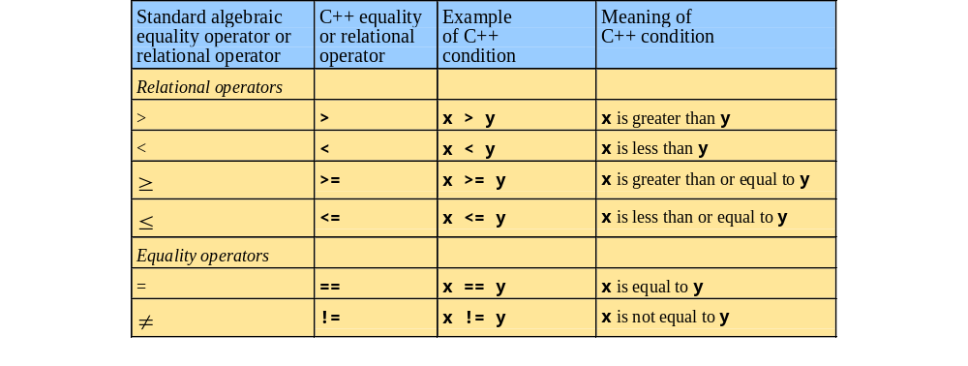
Decision Making: Equality and Relational Operators

Slide 26
Decision Making: Equality and Relational Operators
if structure
  Make decision based on truth or falsity of condition
    If condition met, body executed
    Else, body not executed
Equality and relational operators
  Equality operators
    Same level of precedence
  Relational operators
    Same level of precedence
  Associate left to right
using statements
  Eliminate use of std:: prefix
  Write cout instead of std::cout

Slide 27

WAP to input two numbers and show the relationship between them: Equality and relation

Slide 28
fig01_14.cpp
(1 of 2)
1 // Fig. 1.14: fig01_14.cpp
2 // Using if statements, relational
3 // operators, and equality operators.
4 #include <iostream>
5
6 using std::cout; // program uses cout
7 using std::cin; // program uses cin
8 using std::endl; // program uses endl
9
10 // function main begins program execution
11 int main()
12 {
13 int num1; // first number to be read from user
14 int num2; // second number to be read from user
15
16 cout << "Enter two integers, and I will tell you\n"
17 << "the relationships they satisfy: ";
18 cin >> num1 >> num2; // read two integers
19
20 if ( num1 == num2 )
21 cout << num1 << " is equal to " << num2 << endl;
22
23 if ( num1 != num2 )
24 cout << num1 << " is not equal to " << num2 << endl;
25
using statements eliminate need for std:: prefix.
Declare variables.
Can write cout and cin without std:: prefix.
if structure compares values of num1 and num2 to test for equality.
If condition is true (i.e., values are equal), execute this statement.
if structure compares values of num1 and num2 to test for inequality.
If condition is true (i.e., values are not equal), execute this statement.

Slide 29
fig01_14.cpp
(2 of 2) fig01_14.cpp output (1 of 2)
26 if ( num1 < num2 )
27 cout << num1 << " is less than " << num2 << endl;
28
29 if ( num1 > num2 )
30 cout << num1 << " is greater than " << num2 << endl;
31
32 if ( num1 <= num2 )
33 cout << num1 << " is less than or equal to "
34 << num2 << endl;
35
36 if ( num1 >= num2 )
37 cout << num1 << " is greater than or equal to "
38 << num2 << endl;
39
40 return 0; // indicate that program ended successfully
41
42 } // end function main
Statements may be split over several lines.
Enter two integers, and I will tell you
the relationships they satisfy: 22 12
22 is not equal to 12
22 is greater than 12
22 is greater than or equal to 12

Slide 30
Algorithms
Computing problems
  Solved by executing a series of actions in a specific order
Algorithm a procedure determining
  Actions to be executed
  Order to be executed
  Example: recipe
Program control
  Specifies the order in which statements are executed

Slide 31
Pseudocode
Pseudocode
  Artificial, informal language used to develop algorithms
  Similar to everyday English
Not executed on computers
  Used to think out program before coding
    Easy to convert into C++ program
  Only executable statements
    No need to declare variables

Slide 32
Control Structures
Sequential execution
  Statements executed in order
Transfer of control
  Next statement executed not next one in sequence
  Structured programming – “goto”-less programming
3 control structures to build any program
  Sequence structure
    Programs executed sequentially by default
  Selection structures
    if, if/else, switch
  Repetition structures
    while, do/while, for

Slide 33
Control Structures
Flowchart
  Graphical representation of an algorithm
  Special-purpose symbols connected by arrows (flowlines)
  Rectangle symbol (action symbol)
    Any type of action
  Oval symbol
    Beginning or end of a program, or a section of code (circles)
Single-entry/single-exit control structures
  Connect exit point of one to entry point of the next
  Control structure stacking

Slide 34
if Selection Structure
Selection structure
  Choose among alternative courses of action
  Pseudocode example:
      If student’s grade is greater than or equal to 60
      Print “Passed”
  If the condition is true
    Print statement executed, program continues to next statement
  If the condition is false
    Print statement ignored, program continues
  Indenting makes programs easier to read
    C++ ignores whitespace characters (tabs, spaces, etc.)

Slide 35
if Selection Structure
Translation into C++
      If student’s grade is greater than or equal to 60
      Print “Passed”
      if ( grade >= 60 )
      cout << "Passed";
Diamond symbol (decision symbol)
  Indicates decision is to be made
  Contains an expression that can be true or false
    Test condition, follow path
if structure
  Single-entry/single-exit

Slide 36
if Selection Structure
Flowchart of pseudocode statement
A decision can be made on any expression.
zero - false
nonzero - true
Example:
3 - 4 is true
true
grade >= 60
print “Passed”
false

Slide 37
if/else Selection Structure
if
  Performs action if condition true
if/else
  Different actions if conditions true or false
Pseudocode
    if student’s grade is greater than or equal to 60
    print “Passed”
    else
    print “Failed”
C++ code
    if ( grade >= 60 )
    cout << "Passed";
    else
    cout << "Failed";

Slide 38
if/else Selection Structure
Ternary conditional operator (?:)
  Three arguments (condition, value if true, value if false)
Code could be written:
cout << ( grade >= 60 ? “Passed” : “Failed” );
Condition
Value if true
Value if false
false
true
grade >= 60
print “Failed”
print “Passed”

Slide 39
if/else Selection Structure
Nested if/else structures
  One inside another, test for multiple cases
  Once condition met, other statements skipped
  if student’s grade is greater than or equal to 90
  Print “A”
  else
  if student’s grade is greater than or equal to 80
  Print “B”
  else
  if student’s grade is greater than or equal to 70
  Print “C”
  else
  if student’s grade is greater than or equal to 60
  Print “D”
  else
    Print “F”

Slide 40
if/else Selection Structure
Example
if ( grade >= 90 ) // 90 and above
cout << "A";
else if ( grade >= 80 ) // 80-89
cout << "B";
else if ( grade >= 70 ) // 70-79
cout << "C";
else if ( grade >= 60 ) // 60-69
cout << "D";
else // less than 60
cout << "F";

Slide 41
if/else Selection Structure
Compound statement
  Set of statements within a pair of braces
  if ( grade >= 60 )
  cout << "Passed.\n";
  else {
  cout << "Failed.\n";
  cout << "You must take this course again.\n";
  }
  Without braces,
  cout << "You must take this course again.\n";
  always executed
Block
  Set of statements within braces

Slide 42
while Repetition Structure
Repetition structure
  Action repeated while some condition remains true
  Psuedocode
    while there are more items on my shopping list
    Purchase next item and cross it off my list
  while loop repeated until condition becomes false
Example
      int product = 2;
      while ( product <= 1000 )
      product = 2 * product;

Slide 43
while Repetition Structure
Flowchart of while loop
true
product <= 1000
product = 2 * product
false

Slide 44
Counter-Controlled Repetition
Counter-controlled repetition
  Loop repeated until counter reaches certain value
Definite repetition
  Number of repetitions known
Example
  A class of ten students took a quiz. The grades (integers in the range 0 to 100) for this quiz are available to you. Determine the class average on the quiz.

Slide 45
fig02_07.cpp
(1 of 2)
1 // Fig. 2.7: fig02_07.cpp
2 // Class average program with counter-controlled repetition.
3 #include <iostream>
4
5 using std::cout;
6 using std::cin;
7 using std::endl;
8
9 // function main begins program execution
10 int main()
11 {
12 int total; // sum of grades input by user
13 int gradeCounter; // number of grade to be entered next
14 int grade; // grade value
15 int average; // average of grades
16
17 // initialization phase
18 total = 0; // initialize total
19 gradeCounter = 1; // initialize loop counter
20

Slide 46
fig02_07.cpp
(2 of 2) fig02_07.cpp output (1 of 1)
21 // processing phase
22 while ( gradeCounter <= 10 ) { // loop 10 times
23 cout << "Enter grade: "; // prompt for input
24 cin >> grade; // read grade from user
25 total = total + grade; // add grade to total
26 gradeCounter = gradeCounter + 1; // increment counter
27 }
28
29 // termination phase
30 average = total / 10; // integer division
31
32 // display result
33 cout << "Class average is " << average << endl;
34
35 return 0; // indicate program ended successfully
36
37 } // end function main
The counter gets incremented each time the loop executes. Eventually, the counter causes the loop to end.
Enter grade: 98
Enter grade: 76
Enter grade: 71
Enter grade: 87
Enter grade: 83
Enter grade: 90
Enter grade: 57
Enter grade: 79
Enter grade: 82
Enter grade: 94
Class average is 81

Slide 47
Sentinel-Controlled Repetition
Suppose problem becomes:
  Develop a class-averaging program that will process an arbitrary number of grades each time the program is run
  Unknown number of students
  How will program know when to end?
Sentinel value
  Indicates “end of data entry”
  Loop ends when sentinel input
  Sentinel chosen so it cannot be confused with regular input
    -1 in this case

Slide 48
fig02_09.cpp
(1 of 3)
1 // Fig. 2.9: fig02_09.cpp
2 // Class average program with sentinel-controlled repetition.
3 #include <iostream>
4
5 using std::cout;
6 using std::cin;
7 using std::endl;
8 using std::fixed;
9
10 #include <iomanip> // parameterized stream manipulators
11
12 using std::setprecision; // sets numeric output precision
13
14 // function main begins program execution
15 int main()
16 {
17 int total; // sum of grades
18 int gradeCounter; // number of grades entered
19 int grade; // grade value
20
21 double average; // number with decimal point for average
22
23 // initialization phase
24 total = 0; // initialize total
25 gradeCounter = 0; // initialize loop counter
Data type double used to represent decimal numbers.

Slide 49
fig02_09.cpp
(2 of 3)
26
27 // processing phase
28 // get first grade from user
29 cout << "Enter grade, -1 to end: "; // prompt for input
30 cin >> grade; // read grade from user
31
32 // loop until sentinel value read from user
33 while ( grade != -1 ) {
34 total = total + grade; // add grade to total
35 gradeCounter = gradeCounter + 1; // increment counter
36
37 cout << "Enter grade, -1 to end: "; // prompt for input
38 cin >> grade; // read next grade
39
40 } // end while
41
42 // termination phase
43 // if user entered at least one grade ...
44 if ( gradeCounter != 0 ) {
45
46 // calculate average of all grades entered
47 average = static_cast< double >( total ) / gradeCounter;
48
static_cast<double>() treats total as a double temporarily (casting).
Required because dividing two integers truncates the remainder.
gradeCounter is an int, but it gets promoted to double.

Slide 50
fig02_09.cpp
(3 of 3) fig02_09.cpp output (1 of 1)
49 // display average with two digits of precision
50 cout << "Class average is " << setprecision( 2 )
51 << fixed << average << endl;
52
53 } // end if part of if/else
54
55 else // if no grades were entered, output appropriate message
56 cout << "No grades were entered" << endl;
57
58 return 0; // indicate program ended successfully
59
60 } // end function main
setprecision(2)prints two digits past decimal point (rounded to fit precision).
Programs that use this must include <iomanip>
Enter grade, -1 to end: 75
Enter grade, -1 to end: 94
Enter grade, -1 to end: 97
Enter grade, -1 to end: 88
Enter grade, -1 to end: 70
Enter grade, -1 to end: 64
Enter grade, -1 to end: 83
Enter grade, -1 to end: 89
Enter grade, -1 to end: -1
Class average is 82.50
fixed forces output to print in fixed point format (not scientific notation). Also, forces trailing zeros and decimal point to print.
Include <iostream>

Slide 51
switch Multiple-Selection Structure
switch
  Test variable for multiple values
  Series of case labels and optional default case
switch ( variable ) {
case value1: // taken if variable == value1
statements
break; // necessary to exit switch
case value2:
case value3: // taken if variable == value2 or == value3
statements
break;
default: // taken if none matches
statements
break;
}

Slide 52
switch Multiple-Selection Structure
case a
true
case a action(s)
break
false
case b
true
case b action(s)
break
false
.
.
.
case z
true
case z action(s)
break
false
default action(s)

Slide 53
switch Multiple-Selection Structure
Example upcoming
  Program to read grades (A-F)
  Display number of each grade entered
Details about characters
  Single characters typically stored in a char data type
    char a 1-byte integer, so chars can be stored as ints
  Can treat character as int or char
    97 is the numerical representation of lowercase ‘a’ (ASCII)
    Use single quotes to get numerical representation of character
    cout << "The character (" << 'a' << ") has the value "
    << static_cast< int > ( 'a' ) << endl;
    Prints
    The character (a) has the value 97

Slide 54
fig02_22.cpp
(1 of 4)
1 // Fig. 2.22: fig02_22.cpp
2 // Counting letter grades.
3 #include <iostream>
4
5 using std::cout;
6 using std::cin;
7 using std::endl;
8
9 // function main begins program execution
10 int main()
11 {
12 int grade; // one grade
13 int aCount = 0; // number of As
14 int bCount = 0; // number of Bs
15 int cCount = 0; // number of Cs
16 int dCount = 0; // number of Ds
17 int fCount = 0; // number of Fs
18
19 cout << "Enter the letter grades." << endl
20 << "Enter the EOF character to end input." << endl;
21

Slide 55
fig02_22.cpp
(2 of 4)
22 // loop until user types end-of-file key sequence
23 while ( ( grade = cin.get() ) != EOF ) {
24
25 // determine which grade was input
26 switch ( grade ) { // switch structure nested in while
27
28 case 'A': // grade was uppercase A
29 case 'a': // or lowercase a
30 ++aCount; // increment aCount
31 break; // necessary to exit switch
32
33 case 'B': // grade was uppercase B
34 case 'b': // or lowercase b
35 ++bCount; // increment bCount
36 break; // exit switch
37
38 case 'C': // grade was uppercase C
39 case 'c': // or lowercase c
40 ++cCount; // increment cCount
41 break; // exit switch
42
break causes switch to end and the program continues with the first statement after the switch structure.
cin.get() uses dot notation (explained chapter 6). This function gets 1 character from the keyboard (after Enter pressed), and it is assigned to grade.
cin.get() returns EOF (end-of-file) after the EOF character is input, to indicate the end of data. EOF may be ctrl-d or ctrl-z, depending on your OS.
Assignment statements have a value, which is the same as the variable on the left of the =. The value of this statement is the same as the value returned by cin.get().
This can also be used to initialize multiple variables:
a = b = c = 0;
Compares grade (an int) to the numerical representations of A and a.

Slide 56
fig02_22.cpp
(3 of 4)
43 case 'D': // grade was uppercase D
44 case 'd': // or lowercase d
45 ++dCount; // increment dCount
46 break; // exit switch
47
48 case 'F': // grade was uppercase F
49 case 'f': // or lowercase f
50 ++fCount; // increment fCount
51 break; // exit switch
52
53 case '\n': // ignore newlines,
54 case '\t': // tabs,
55 case ' ': // and spaces in input
56 break; // exit switch
57
58 default: // catch all other characters
59 cout << "Incorrect letter grade entered."
60 << " Enter a new grade." << endl;
61 break; // optional; will exit switch anyway
62
63 } // end switch
64
65 } // end while
66
This test is necessary because Enter is pressed after each letter grade is input. This adds a newline character that must be removed. Likewise, we want to ignore any whitespace.
Notice the default statement, which catches all other cases.

Slide 57
fig02_22.cpp
(4 of 4)
67 // output summary of results
68 cout << "\n\nTotals for each letter grade are:"
69 << "\nA: " << aCount // display number of A grades
70 << "\nB: " << bCount // display number of B grades
71 << "\nC: " << cCount // display number of C grades
72 << "\nD: " << dCount // display number of D grades
73 << "\nF: " << fCount // display number of F grades
74 << endl;
75
76 return 0; // indicate successful termination
77
78 } // end function main

Slide 58
do/while Repetition Structure
Similar to while structure
  Makes loop continuation test at end, not beginning
  Loop body executes at least once
Format
    do {
    statement
    } while ( condition );
action(s)
true
condition
false

Slide 59
fig02_24.cpp
(1 of 1) fig02_24.cpp output (1 of 1)
1 // Fig. 2.24: fig02_24.cpp
2 // Using the do/while repetition structure.
3 #include <iostream>
4
5 using std::cout;
6 using std::endl;
7
8 // function main begins program execution
9 int main()
10 {
11 int counter = 1; // initialize counter
12
13 do {
14 cout << counter << " "; // display counter
15 } while ( ++counter <= 10 ); // end do/while
16
17 cout << endl;
18
19 return 0; // indicate successful termination
20
21 } // end function main
Notice the preincrement in loop-continuation test.
1 2 3 4 5 6 7 8 9 10

Slide 60
break and continue Statements
break statement
  Immediate exit from while, for, do/while, switch
  Program continues with first statement after structure
Common uses
  Escape early from a loop
  Skip the remainder of switch

Slide 61
fig02_26.cpp
(1 of 2)
1 // Fig. 2.26: fig02_26.cpp
2 // Using the break statement in a for structure.
3 #include <iostream>
4
5 using std::cout;
6 using std::endl;
7
8 // function main begins program execution
9 int main()
10 {
11
12 int x; // x declared here so it can be used after the loop
13
14 // loop 10 times
15 for ( x = 1; x <= 10; x++ ) {
16
17 // if x is 5, terminate loop
18 if ( x == 5 )
19 break; // break loop only if x is 5
20
21 cout << x << " "; // display value of x
22
23 } // end for
24
25 cout << "\nBroke out of loop when x became " << x << endl;
Exits for structure when break executed.

Slide 62
Logical Operators
Used as conditions in loops, if statements
&& (logical AND)
  true if both conditions are true
  if ( gender == 1 && age >= 65 )
  ++seniorFemales;
|| (logical OR)
  true if either of condition is true
  if ( semesterAverage >= 90 || finalExam >= 90 )
  cout << "Student grade is A" << endl;

Slide 63
Logical Operators
! (logical NOT, logical negation)
  Returns true when its condition is false, & vice versa
  if ( !( grade == sentinelValue ) )
  cout << "The next grade is " << grade << endl;
  Alternative:
  if ( grade != sentinelValue )
  cout << "The next grade is " << grade << endl;

Slide 64
Confusing Equality (==) and Assignment (=) Operators
Common error
  Does not typically cause syntax errors
Aspects of problem
  Expressions that have a value can be used for decision
    Zero = false, nonzero = true
  Assignment statements produce a value (the value to be assigned)

Slide 65
Confusing Equality (==) and Assignment (=) Operators
Example
    if ( payCode == 4 )
    cout << "You get a bonus!" << endl;
  If paycode is 4, bonus given
If == was replaced with =
    if ( payCode = 4 )
    cout << "You get a bonus!" << endl;
  Paycode set to 4 (no matter what it was before)
  Statement is true (since 4 is non-zero)
  Bonus given in every case

Slide 66
Confusing Equality (==) and Assignment (=) Operators
Lvalues
  Expressions that can appear on left side of equation
  Can be changed (I.e., variables)
    x = 4;
Rvalues
  Only appear on right side of equation
  Constants, such as numbers (i.e. cannot write 4 = x;)
Lvalues can be used as rvalues, but not vice versa

Slide 67
Structured-Programming Summary
Structured programming
  Programs easier to understand, test, debug and modify
Rules for structured programming
  Only use single-entry/single-exit control structures
  Rules
    1) Begin with the “simplest flowchart”
    2) Any rectangle (action) can be replaced by two rectangles (actions) in sequence
    3) Any rectangle (action) can be replaced by any control structure (sequence, if, if/else, switch, while, do/while or for)
    4) Rules 2 and 3 can be applied in any order and multiple times

Slide 68
Structured-Programming Summary
Representation of Rule 3 (replacing any rectangle with a control structure)
Rule 3
Rule 3
Rule 3

Slide 69
Structured-Programming Summary
All programs broken down into
  Sequence
  Selection
    if, if/else, or switch
    Any selection can be rewritten as an if statement
  Repetition
    while, do/while or for
    Any repetition structure can be rewritten as a while statement

